Slide 1

Data Preparation
Notes:
In this section we’re going to go over how to retrieve and prepare your data for analysis in GenePattern.
In this section we’re going to retrieve gene count files from TCGA (The Cancer Genome Atlas). This will include 20 breast cancer primary tumor samples (BRCA) and 20 corresponding normal samples. We’re then going to replace the Ensemble Gene IDs in the samples with HUGA gene symbols, which are easier for humans to read. We’re then going to use the VoomNormalize module to normalize the data into something approximating a normal distribution. And this is important because it will later allow us to apply statistical methods and workflows that assume a normal distribution .
So with that said, let’s jump right in and start going through the notebook. And I will talk a bit more about the data formats we use once we the processing started.
<Run the notebook up through TCGAImporter.>

Slide 2
Our Research Objective
Find genes whose activity is most different between breast cancer tissue and matched normal tissue.
Identify a dataset with matched tumor/normal pairs – TCGA RNA-seq
Combine sample files into a matrix - match the format for GenePattern’s modules
Combine transcript-level counts to gene-level – more human-readable and the right format for other possible downstream analyses
Normalize for downstream analysis - transform the dataset to fit an approximation of a normal distribution, with the goal of being able to apply classic normal-based microarray-oriented statistical methods
Notes:
So for this section and several that follow, we’ll use this as our scientific problem.
This is actually a pretty easy problem technically speaking, at least it is in 2018. To start we need some data. For that we’ll go to the The Cancer Genome Atlas, TCGA, which has a breast cancer RNA-Seq read count dataset that includes matched normal from peripheral blood.
Now given that we are using GenePattern here, we want to get the TCGA data, which exists as a separate file of read counts for each sample, into a matrix with one column per sample, which is GenePattern’s standard format for gene expression data.
The TCGA data is given using ensemble transcripts ids for the counts, but we want to convert this to HUGO symbols partly because they are more human readable, and partly because it opens up other downstream analysis alternatives which you will hear about later today (GSEA)
While there are methods specific to rnaseq we could use (cuffdiff, deseq2) we also want to be able to use general machine learning techniques that are available in GenePattern. So we will also want to normalize the RNA-seq read count data to adapt it to something approximating a normal distribution to allow the statistical tools that were developed for microarray data, which assume a normal distribution, to be used on the RNASeq data.

Slide 3
GenePattern file formats
Each module specifies its input and output file formats
Modules may use common GenePattern file formats or their own unique formats
Most modules use the file formats described on the GenePattern website
There are many GenePattern modules that are specifically meant for importing data from other systems
Notes:
Alright, so by now most of you should be waiting for your TCGA data to import. This will take a few minutes as in the background GenePattern is downloading all 40 gene count files for each of you and converting them to GCT format - which I’ll talk about in a moment.
Before then, however, I want to take a look at GenePattern modules in the abstract, because you’re going to be seeing a lot of them in this workshop. And they’re important to understand.
Okay, so as you’ve already seen. GenePattern breaks up analytic workflows into easily digestible steps that we call modules. And each module is presented as interactive cell in a notebook. One of those little web forms with a blue box around it. For example: TCGAImporter, which you just ran.
Every module accepts input, which is the contents of the web form. And every module produces files or some sort of visualization as output.
GenePattern uses many common file formats. And there are many modules that are specifically designed for importing data from other systems.

Slide 4
Example modules for data formatting
Data type | Input Format | Module
RNA-Seq | bed fpkm tracking Read group tracking Cufflinks Expr bed | BedToGtf Fpkm_trackingToGct Read_group_trackingToGct ExprToGct BedToGtf
DNA-seq | bam sam sam/bam | Picard.BamToSam Picard.SamToBam Picard.SamToFastQ
Gene expression chips | .cel | ExpressionFileCreator
SNP chips | .cel | SNPFileCreator
MAGE | Mage-ML Mage-tab | MageMLImportViewer MageTabImportViewer
To find, search modules for “to<format>” or “<format>To” or 2<format> or <format>2
There are many more modules, for MS, FCS and other data types
Notes:
Here are some examples of different types of data, common formats that contains that data and their associated GenePattern modules.
You don’t need to remember this – we’ll be sending links with all slides later. But it demonstrates a few of the formats that GenePattern supports.

Slide 5
GCT file format
Tab delimited
Originally used for expression data
Can be used for any matrix, not just expression
Represents a matrix
columns = samples
rows = features such as genes

Slide 6
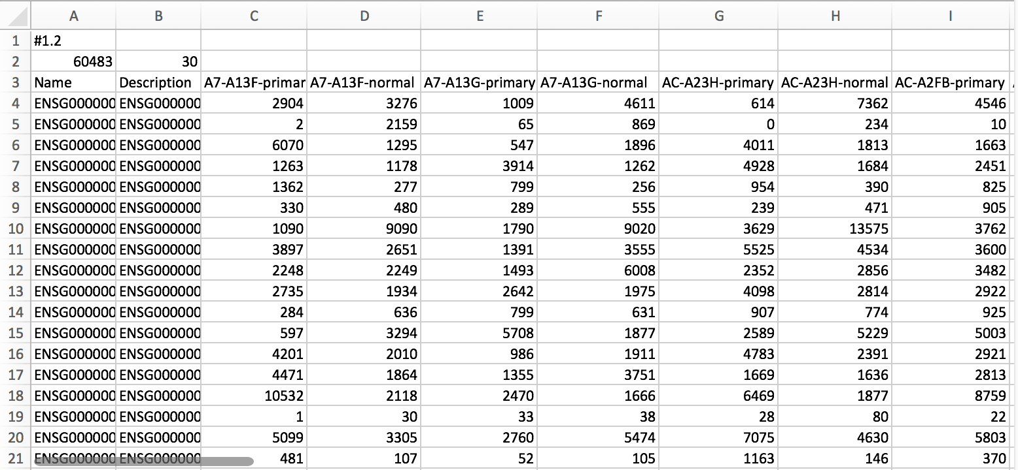
GCT file format
Always #1.2
Number of rows (ie gene ids)
Number of samples
Tab Delimited
Open in any spreadsheet or text editor
Col 1: Row identifiers. Typically gene ids.
Col 2: Optional description
Col 3+: Sample names, must be unique.
Each column contains expression or count values from one sample.
Notes:
The two file formats that we are going to be working with the most today are GCT and CLS.
A GCT - or a gene count file - is essentially a tab-delimited matrix. Each column represents a specific sample, and each row represents a particular gene identifier.
There are also a couple of header lines specifying the version of the GCT format, as well as the total number of identifiers and samples.

Slide 7
Sample info file format
Tab delimited
Essentially a spreadsheet
Used to record properties of samples
Represents a matrix
Columns = properties
Completely arbitrary columns, you can define anything you want
Values can be anything that can be represented by text (except cannot use the tab character)
Rows = Samples

Slide 8
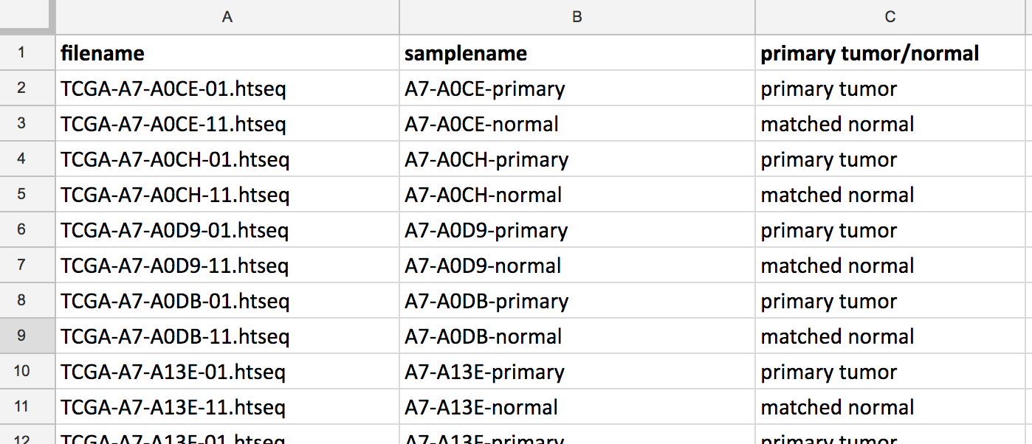
Sample details: sample info file
Tab-delimited, assumes the first row has column names
Any number of columns
Arbitrary column labels (i.e. whatever you want them to be)
One row per sample
Column Labels
One row
per sample
Sample info files are usually created from spreadsheets saved in tab-delimited format

Slide 9
Class (CLS) file format
Tab or space delimited
Used for defining class membership of samples
Values are numeric (0,1,…)

Slide 10
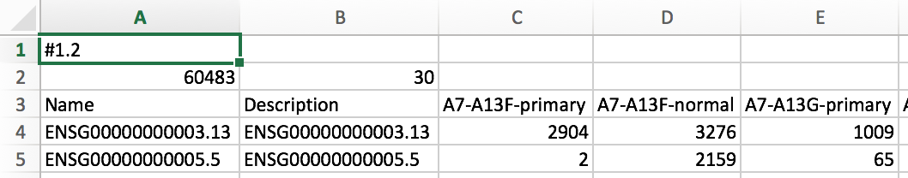
Sample labels: CLS file
30 samples
2 Classes
Numeric values, start with 0
Tab or space delimited
ClsFileCreator module can be used to generate a CLS file from a gct file.
Notes:
CLS files - or class files - on the other hand, help classify samples into different categories. For example, some samples might be classified as primary tumor and others might be classified as normal.
These are paired with an accompanying GCT file, and consist of three lines: the number of samples and classes, the names of each class and an integer identifier mapping each sample to the paired classification.
And those are the two data formats we’re going to be working with the most today.

Slide 11
Data Prep Exercise
Starting with read counts and a sample info file for 40 RNA-seq samples, 20 breast cancer primary tumor and 20 matched normal using Ensembl Transcript IDs:
Download the TCGA Breast Cancer data from the GDC Data Portal as a (gct) matrix and generate a cls file distinguishing tumor/normal samples
Replace Ensembl transcript ids with HUGO symbols & collapse multiple transcripts of the same gene to a single row
Normalize the data for downstream analysis
Results:
A gene expression file (GCT) using HUGO gene symbols
A class file (CLS) that identifies samples as tumor or normal.
suitable to be used for differential gene expression.

Slide 12
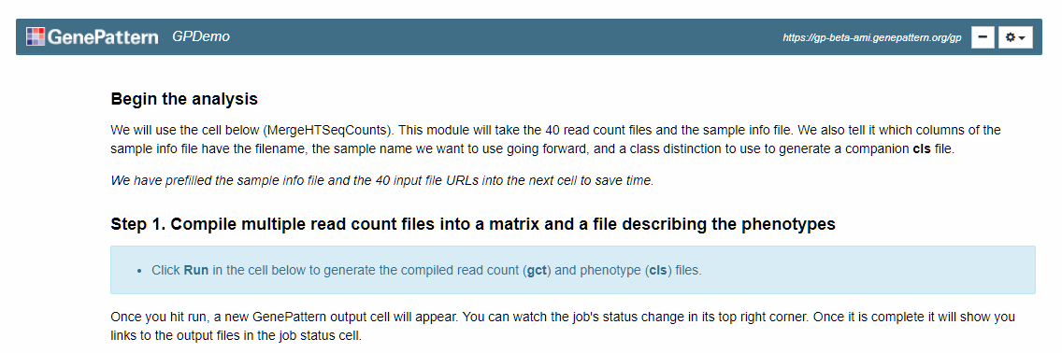
Data Prep Exercise
Click on the notebook “2019-02-21_03_UCSD DataPrep”
Click the “Get a Copy” button.
Open your copy of the notebook and follow along.
Notes:
Merge usually takes less than a minute – note that it can take a little bit for the cell to collapse, as it is connecting to all of the data.
Collapse - same
PreprocessReadCounts - same

Slide 14
ftp://ftp.broadinstitute.org/pub/gsea/annotations/
ENSEMBL_human_gene.chip

